Slide 1


Progress Presentation
Team: 5G

Slide 2

List
table of contents
1
Solve sparsity issue
2
Web page
3
Database
ⓒSaebyeol Yu. Saebyeol’s PowerPoint

Slide 3
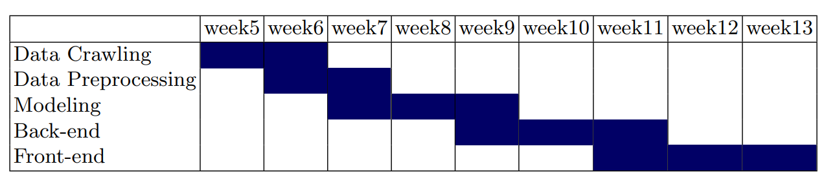
Part 2
Data analysis
Progress schedule

Slide 4


Part 1
Solve sparsity issue
ⓒSaebyeol Yu. Saebyeol’s PowerPoint

Slide 5
Part 2
Length filtering
Description | Value
The number of users | 2887
Average actions of users | 286.82
The number of items | 56965
Average actions of items | 14.53
The number of inters | 827767
The sparsity of the dataset | 99.4%
Description | Value
The number of users | 2866
Average actions of users | 252.57
The number of items | 10742
Average actions of items | 367.37
The number of inters | 723629
The sparsity of the dataset | 97.6%
Over 10 click user

Slide 6
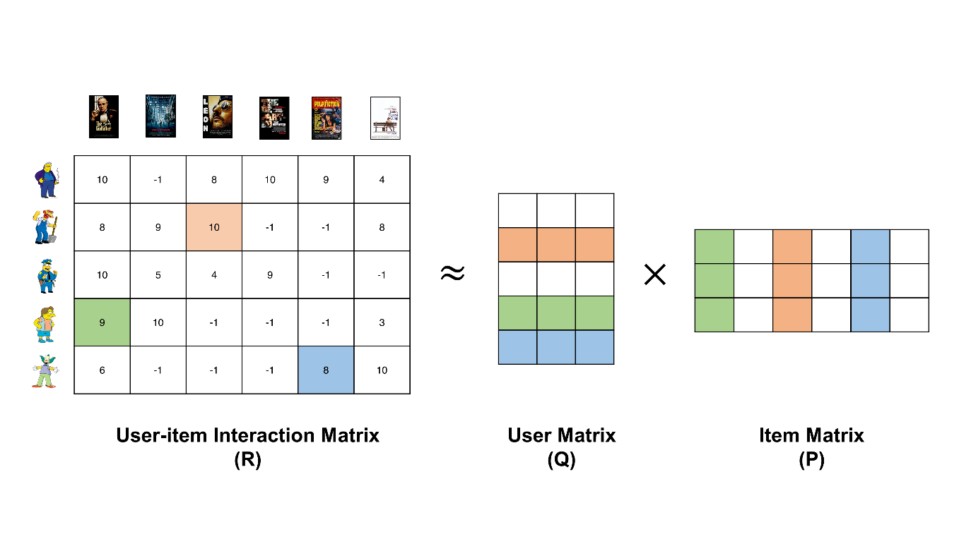

Part 2
Matrix Factorization

Slide 7
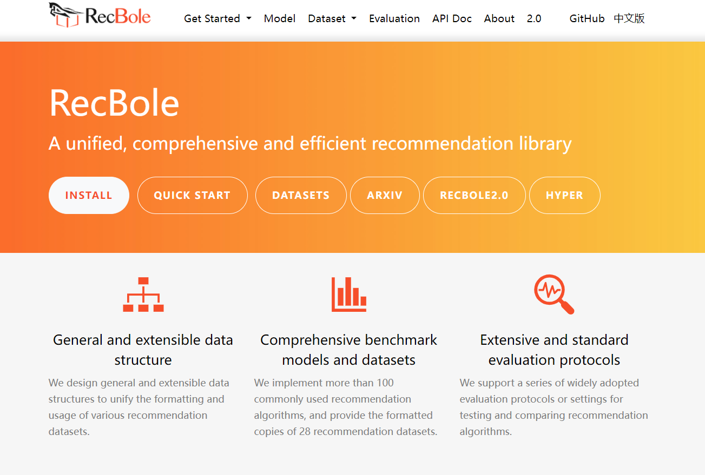
Part 2
Recbole

Slide 8
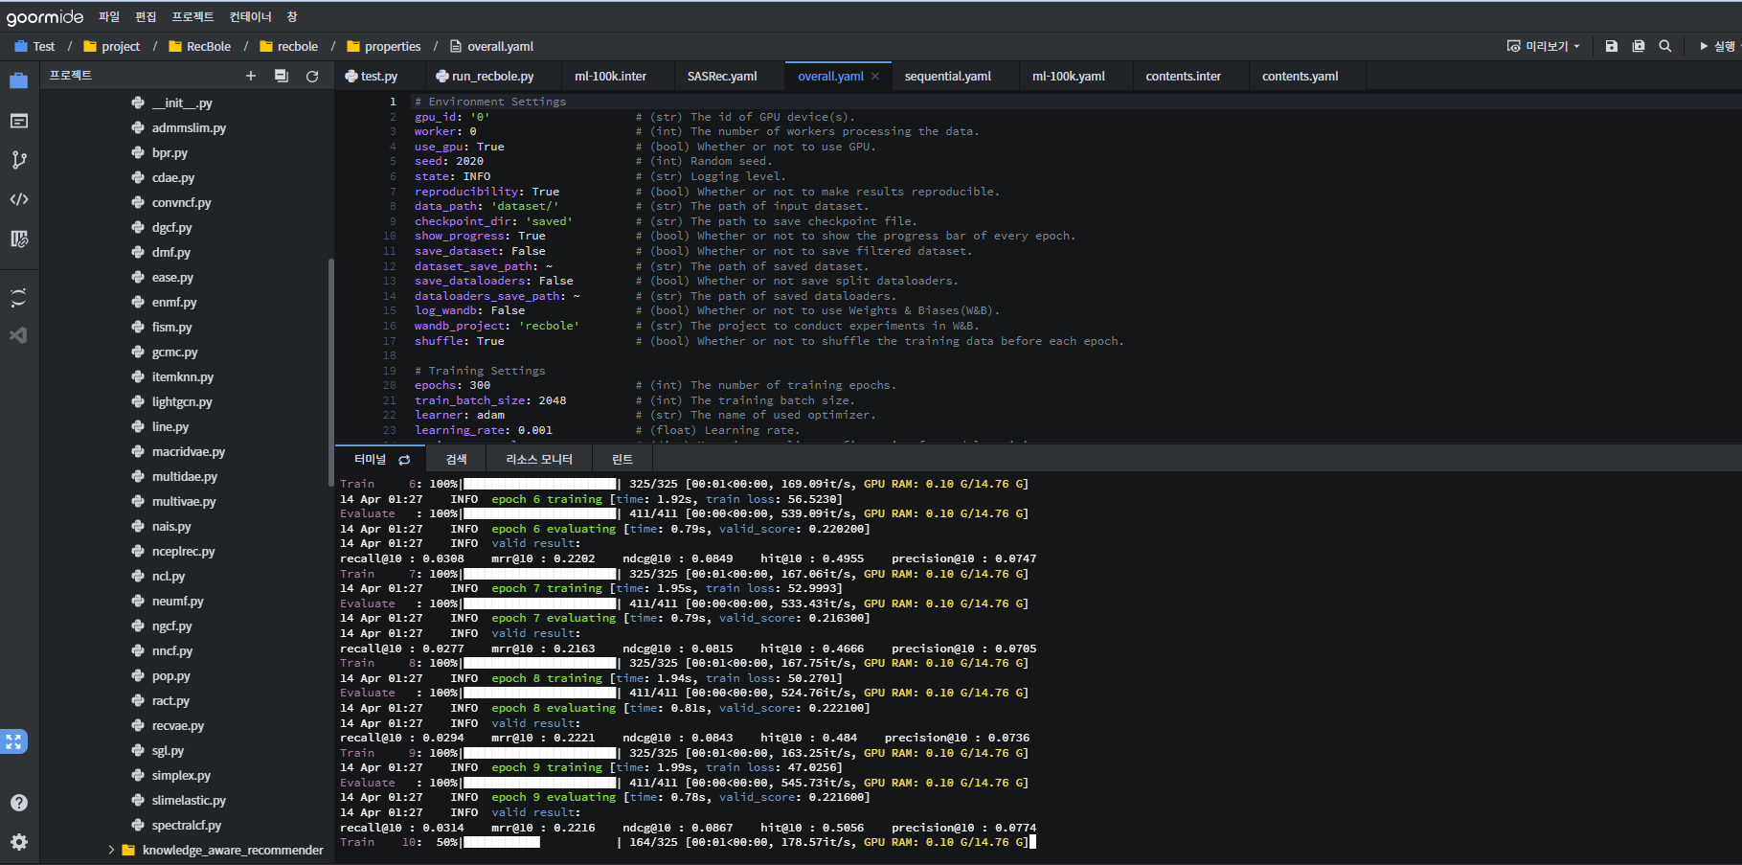
Part 2
Goorm ide

Slide 9
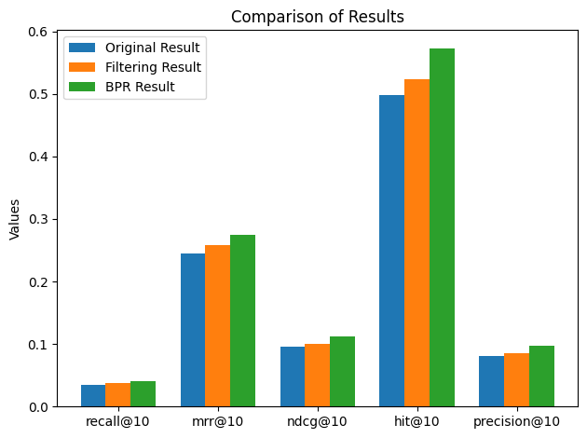
Part 2
evaluation
The results after filtering show higher performance.
BPR showed the best performance

Slide 10

Part 2
Web page
ⓒSaebyeol Yu. Saebyeol’s PowerPoint

Slide 11
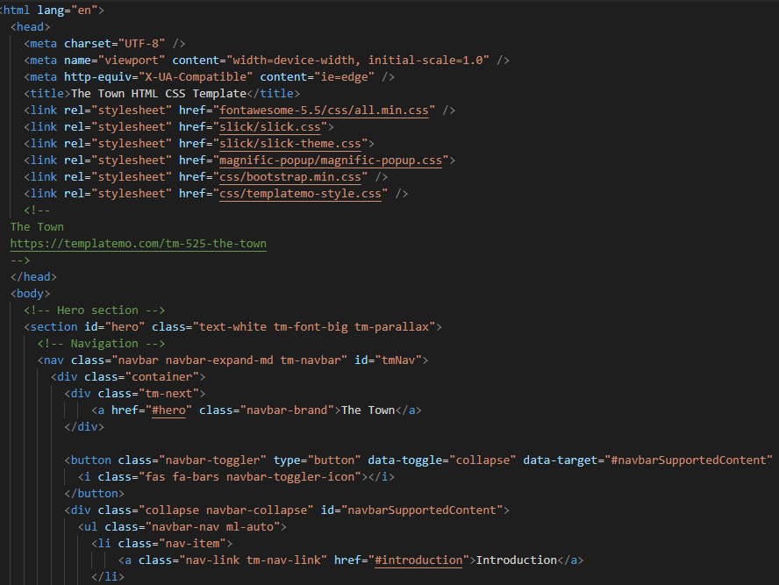
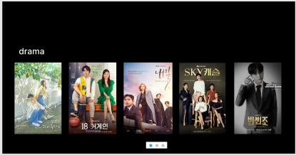
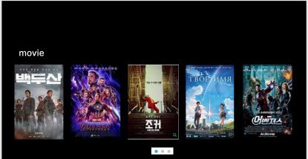
Part 2
Web page
Notes:
In this week, we made a frontend page for contents display. We used html and css, and bootstrap and jquery.

Slide 12
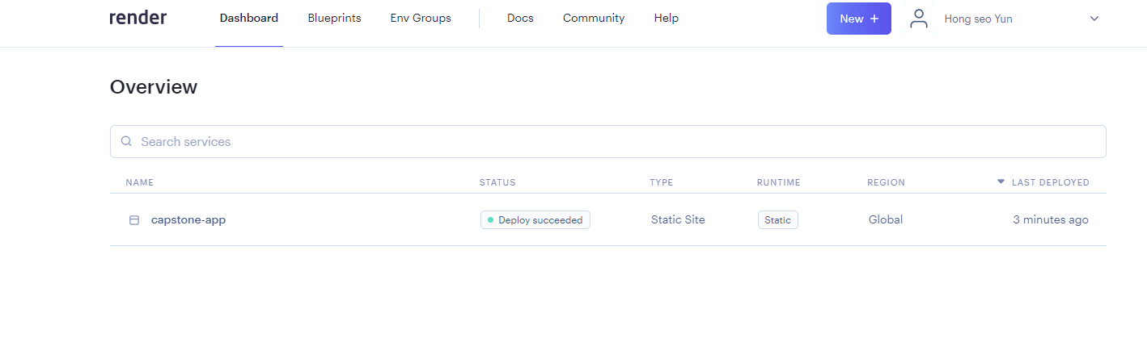
Part 2
Web page

Slide 13
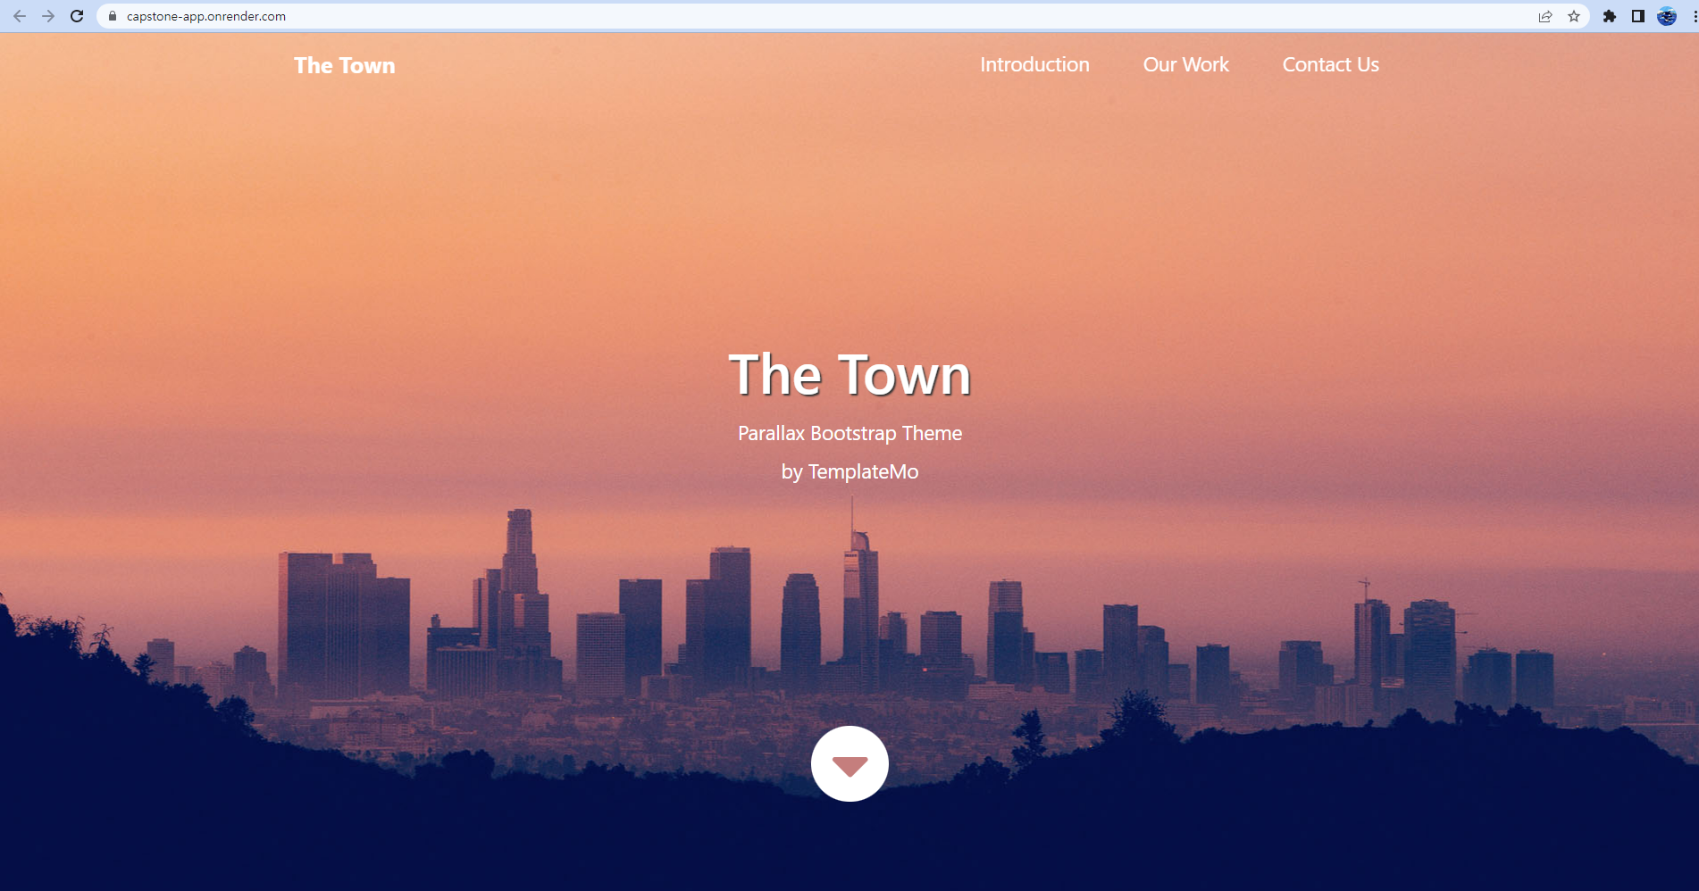
Part 2
Web page
Free Template reference: https://templatemo.com/tm-525-the-town

Slide 14

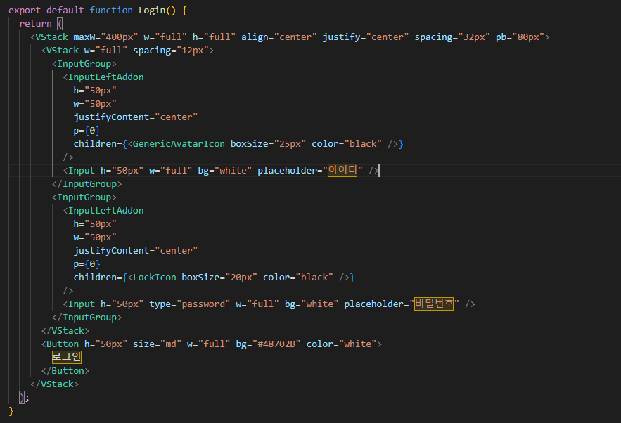
Part 2
Login Page UI

Slide 15
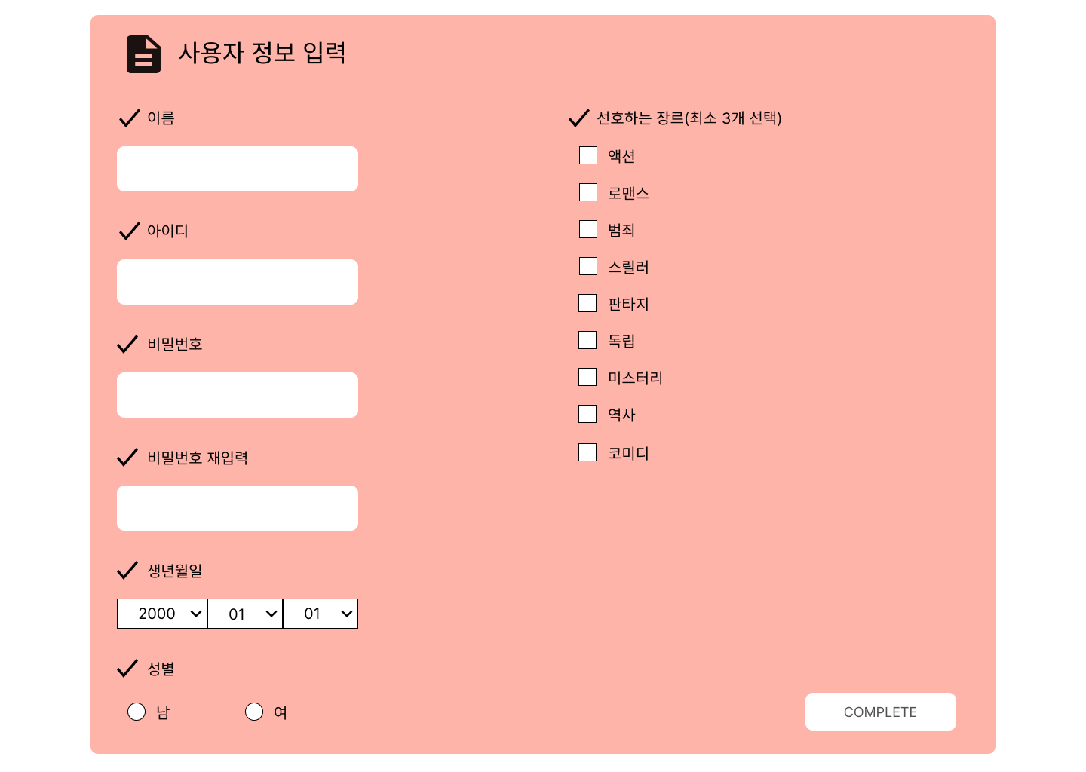
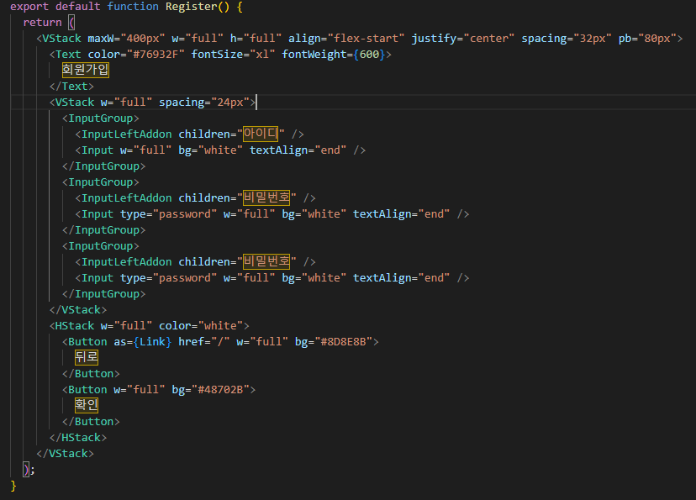
Part 2
Register Page UI

Slide 16


Part 3
Database
ⓒSaebyeol Yu. Saebyeol’s PowerPoint

Slide 17
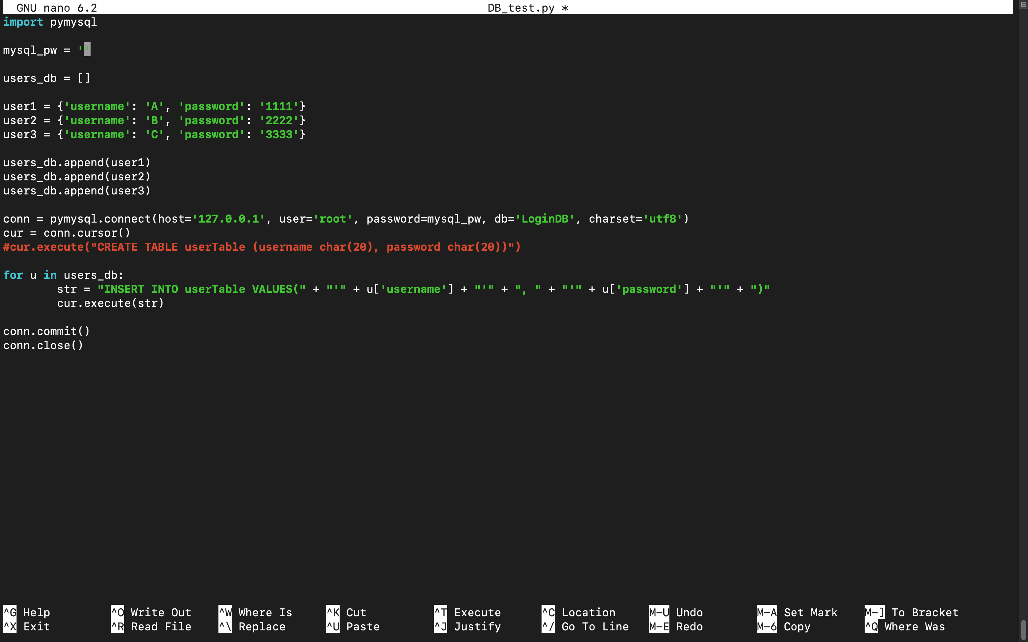

Part 3
Database
Notes:
Since we are going to use FASTAPI framework, we need to connect to database server from Python. Therefore we are going to use PYMYSQL, which is a python library to connect to Mysql server from python. This is an example code we made that inserts given IDs and passwords of users to ‘userTable’ in ‘LoginDB’ of Mysql.

Slide 18
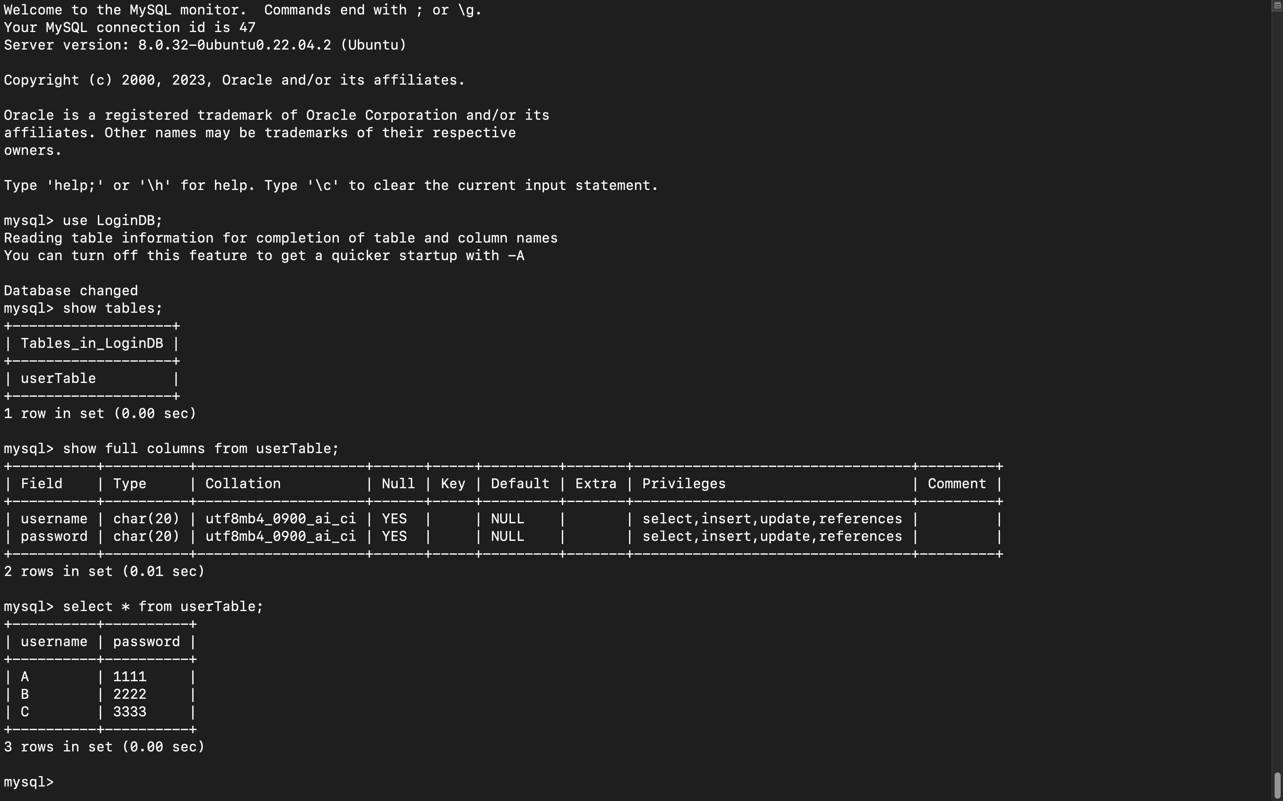
Part 3
Database
Notes:
This is the result in Mysql. Since, we haven’t build a backend server yet, we tested on our PC’s linux virtual machine and using localhost to connect Mysql. We will further design schemas and build database of user data, contents data, train data and etc.

Slide 19
Part 3
Next week
Login/Registration page
Connect with database

Slide 20

Q&A
ⓒSaebyeol Yu. Saebyeol’s PowerPoint

